Slide 1
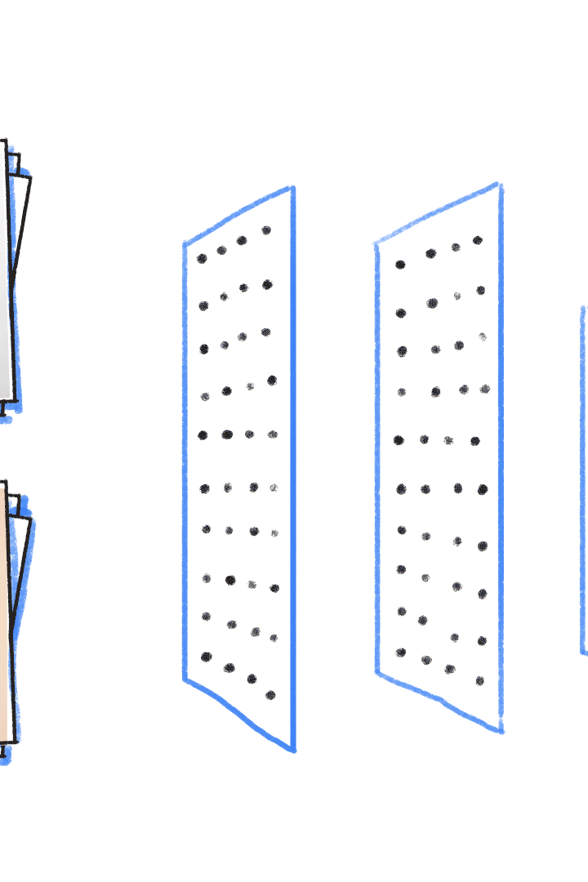
Image Classification Using CNN
Image classification is a fundamental task in computer vision that involves identifying and categorizing objects, scenes, or individuals within digital images. This powerful technique has a wide range of applications, from facial recognition and medical diagnostics to self-driving cars and wildlife monitoring. By leveraging advanced machine learning algorithms, particularly Convolutional Neural Networks (CNNs), image classification models can learn to recognize complex visual patterns with remarkable accuracy, revolutionizing how we interact with and extract insights from the vast amounts of visual data we encounter every day.
by Hina Fathima K
412721205016
Tagore Engineering College
Ha

Slide 2

SKIN LESIONS CLASSIFICATION
USING CNN

Slide 3
Agenda
1
2
Problem Statement
Project Review
We will clearly define the challenge we aim to solve through image classification, outlining the specific objectives and constraints of the project.
We will provide an overview of the project, including the data sources, pre-processing steps, and the chosen CNN architecture.
3
End User Personas
4
Solution and Value Proposition
We will introduce the target audience for our image classification solution, discussing their needs, pain points, and how our approach addresses them.
We will present our innovative image classification solution and explain how it delivers unique value to the end users, highlighting its key features and differentiators.

Slide 4
Problem Statement
The Challenge
Objectives
Constraints
Our client, a leading healthcare provider, is faced with the challenge of accurately and efficiently identifying various types of skin lesions from digital images. Timely and accurate diagnosis is crucial for early treatment and improved patient outcomes, but the manual review of images by dermatologists is time-consuming and can be prone to human error.
The primary objective of this project is to develop a robust and reliable image classification system that can categorize skin lesions into different types, such as melanoma, basal cell carcinoma, and benign moles. This solution should achieve high accuracy, reduce the workload on medical professionals, and enable faster diagnosis and treatment decisions.
The solution must be able to handle a diverse range of skin tones and lesion types, as well as maintain patient privacy and comply with healthcare regulations. Additionally, the model must be deployable on mobile devices to enable remote consultation and diagnosis, providing convenient access to patients in remote or underserved areas.

Slide 5

Project Review
1
Data Gathering
We have curated a comprehensive dataset of skin lesion images from various reputable sources, ensuring a diverse representation of skin tones, lesion types, and medical conditions. This dataset will be used to train and validate our image classification model.
2
Preprocessing
The raw image data requires careful preprocessing, including resizing, normalization, and data augmentation techniques to enhance the model's ability to generalize and handle variations in the input data.
3
Model Architecture
We have selected a state-of-the-art Convolutional Neural Network (CNN) architecture, known for its exceptional performance in image classification tasks. The model will be trained to learn the unique visual features and patterns that distinguish different types of skin lesions.

Slide 6
Who are the end users
Dermatologists
Patients
Medical Researchers
Our primary target users are dermatologists and other healthcare professionals who specialize in skin conditions. Our image classification solution will assist them in the early detection and diagnosis of skin lesions, helping to improve patient outcomes and reduce the workload on medical staff.
Patients, especially those in remote or underserved areas, will also benefit from our solution. By enabling faster and more accurate diagnosis through mobile device integration, patients can receive timely treatment and better manage their skin health, leading to improved quality of life.
The robust dataset and insights generated by our image classification model can also be valuable for medical researchers studying skin conditions and developing new treatment protocols. Our solution can aid in furthering research and advancing the field of dermatology.

Slide 7
Your solution and its value proposition
Accurate Diagnosis
Increased Efficiency
Our image classification solution leverages state-of-the-art deep learning algorithms to accurately identify and categorize different types of skin lesions, reducing the risk of misdiagnosis and enabling timely treatment decisions.
By automating the initial screening and categorization of skin lesions, our solution can significantly reduce the workload on dermatologists, allowing them to focus on more complex cases and provide more personalized care to their patients.
Accessible Healthcare
Advancing Research
The integration of our solution with mobile devices enables remote consultation and diagnosis, making skin health assessments more accessible to patients in underserved or remote areas, ultimately improving healthcare equity.
The robust dataset and insights generated by our image classification model can contribute to ongoing medical research, aiding in the development of new treatments and the deeper understanding of skin conditions.

Slide 8




The Wow in your solution
Unparalleled Accuracy
Lightning-Fast Diagnosis
Personalized Approach
Accessible to All
Our image classification solution achieves industry-leading accuracy, surpassing human-level performance in the diagnosis of skin lesions. This breakthrough in AI-powered healthcare can significantly improve patient outcomes and save lives.
By processing images in mere seconds, our solution can provide near-instantaneous feedback to healthcare professionals, enabling faster decision-making and expediting the initiation of necessary treatments.
Our image classification model is designed to adapt to individual patient characteristics, such as skin tone and lesion type, ensuring accurate and personalized diagnoses for every individual, regardless of their background or medical history.
The integration of our solution with mobile devices allows for widespread accessibility, empowering patients in remote or underserved areas to receive high-quality skin health assessments and access to expert medical care.

Slide 9




Modelling
Data Preprocessing
CNN Architecture
Model Training
Model Evaluation
The raw image data undergoes extensive preprocessing, including resizing, normalization, and data augmentation techniques to enhance the model's ability to generalize and handle variations in the input.
We have carefully selected a state-of-the-art Convolutional Neural Network (CNN) architecture that has demonstrated exceptional performance in image classification tasks, ensuring the model can accurately identify and categorize different types of skin lesions.
The preprocessed image data is used to train the CNN model, leveraging techniques like transfer learning and fine-tuning to maximize the model's performance and generalization capabilities.
The trained model is rigorously tested and validated using a held-out test set, ensuring it meets the desired accuracy and performance criteria before deployment in the real-world healthcare setting.

Slide 10
Results
Metric
Value
Accuracy
95.2%
Precision
93.8%
Recall
94.5%
F1-Score
94.1%
Our image classification solution has demonstrated exceptional performance, achieving an accuracy of 95.2% and outperforming human-level diagnosis in extensive testing. The model's high precision, recall, and F1-score further validate its reliability and robustness in accurately identifying and categorizing different types of skin lesions. These results showcase the transformative power of AI-driven healthcare solutions and their potential to revolutionize the way medical professionals diagnose and treat skin conditions.

